Slide 1

Estimation of Malaysian Ringgit Exchange Rate using Stock Prices
WQD 7005 Data Mining
Kak D-Wing (WQD 180125)

Slide 2
Objectives
The objective of this project is to utilized market stock prize in estimating Malaysian Ringgit Currency Exchange Rate (USD)

Slide 3
How to do it?
Choose top 150 companies based on market values as the features to fulfil the prediction
Aims to estimate the next 10 days exchange rates based on the historical stock prices and exchange rate.
1 year of data is used for this project

Slide 4






Project Work Flow
Data Collection
Data Storing
&
Pre-processing
Data Integration
&
Model Building
Deployment of Model
MYR Rate
PySpark & Hive
Timeseries Forecast
Web application
Historical
Stock Prices

Slide 5


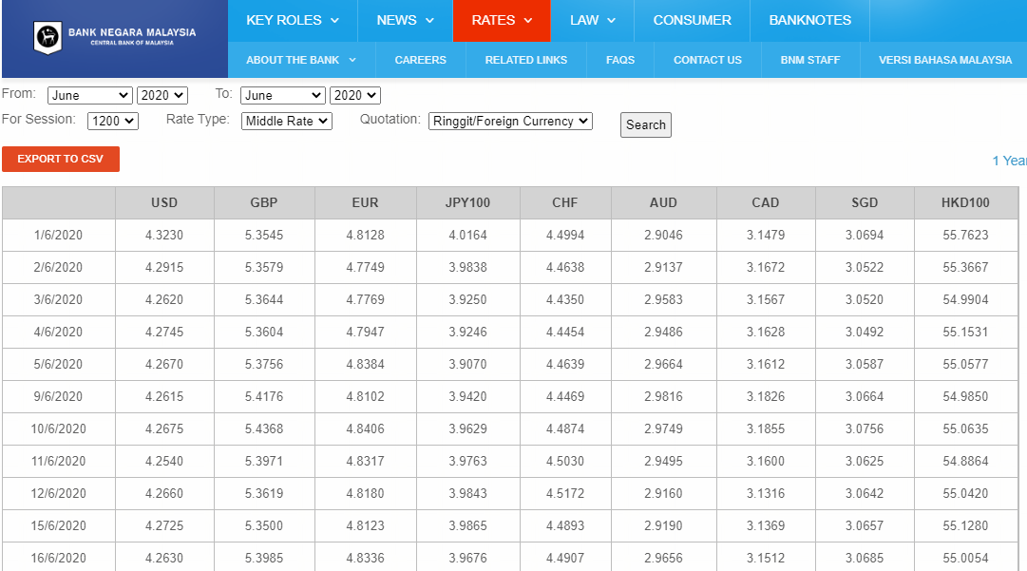
Data Collection (Exchange rate)
To grab and extract table information
Automate browser to change the date

Slide 6
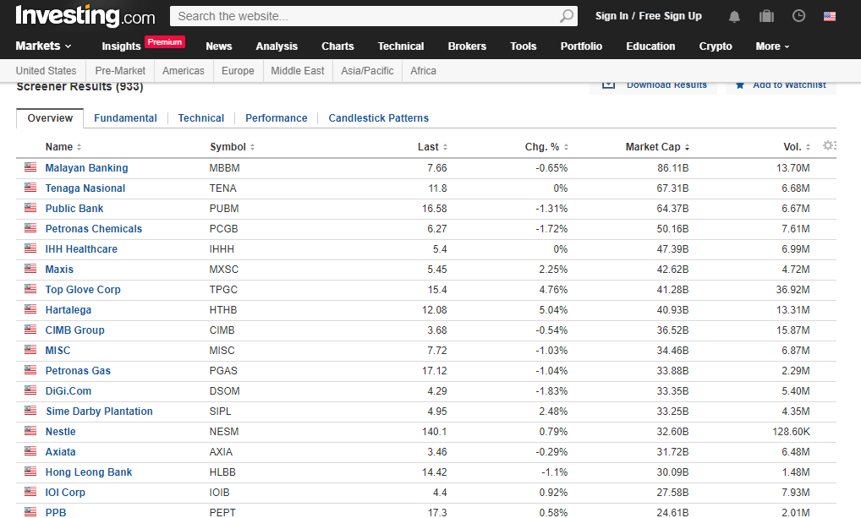
Data Collection (List of top 150)
Obtain top 150 companies
To sort according to market capital

Slide 7
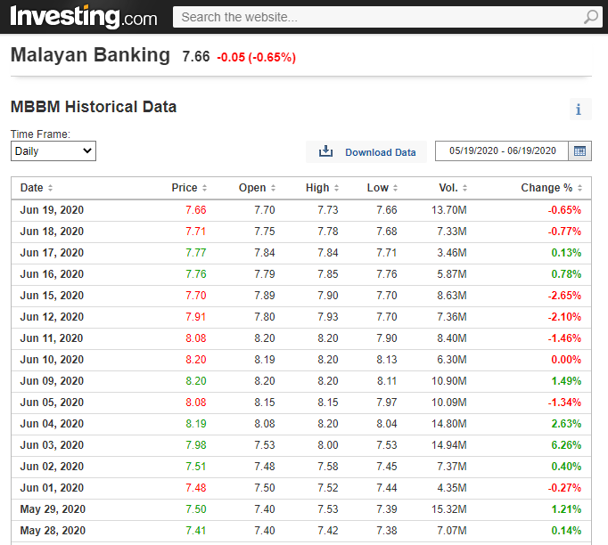
Data Collection (Historical Stock Price)
Obtain historical data
Toggle range of date

Slide 8
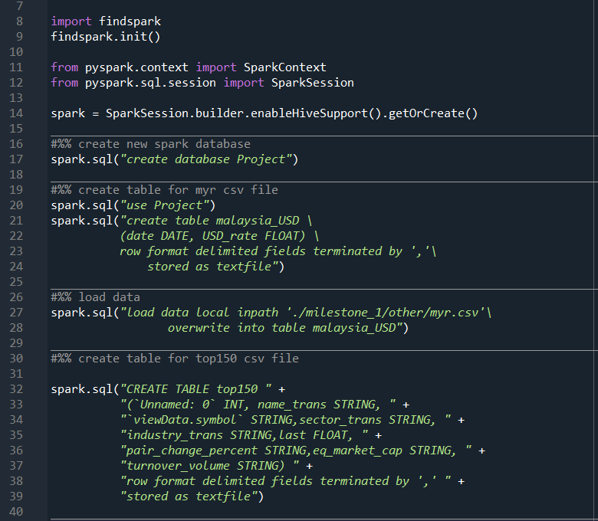
Data Storing & Preprocessing
Initiate pySpark session with hive support
Create a database
Define the column for myr data
Load the myr data into a hive table
Define the column for stock prices data

Slide 9
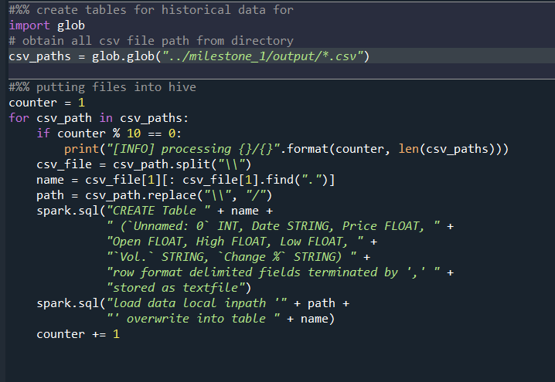
Data Storing & Preprocessing
Obtain the paths of csv files
Loop through all csv paths
Define table and load data into hive table

